Slide 1
Prediction of Ad Clicks

Slide 2

We are
Ashok Vardhan
Karthik Shivkumar
Vamshidar Reddy

Slide 3
Outline
The online classifieds space and Avito.
What are Contextual Ads?
How are Contextual ads different from others?
Understanding Ad Performance user behaviour
Prediction Of Ad Click
Dimension of Ad Popularity
Relationship between the Position and Ad Clicks
Improving Ad Performance

Slide 4
What is AVITO
AVITO.ru - a classifieds site.
140 000 new listings every day
70 million unique monthly visitors
Currently, Avito uses general statistics on ad performance to drive the placement of context ads
Their existing model ignores individual user behavior, making it difficult to predict which ad will be the most relevant for (and earn the most clicks from) each potential buyer

Slide 5
What are Contextual Ads?
Contextual advertising is a form of targeted advertising for advertisements appearing on websites
A contextual advertising system scans the keywords and returns advertisements the context. (Obviously?)
Because the advertisements are targeted, they are more likely to be clicked
Contextual ads can be used in combination with user preferences and behaviour to improve the performance.

Slide 6
Various types of Ads
Regular Ads (Arranged reverse chronologically)
First result was most recently posted.
Different from results from search engine.
Premium Ads (Ads that are paid for)
These ads are paid for by the seller.
Ad positions are based on bids and click through rate.

Slide 7
Objectives of Contextual Marketing
The ultimate objective is to serve ads that customers are interested in.
Clicking on the ad is 90% of the job done.
Customers like to see relevant ads.
Go one step further by removing ads that don’t get click. Space is money.

Slide 8
Click Through Rate (CTR)
It is ratio showing how often people who see your ad end up clicking it.
CTR is the number of clicks that your ad receives divided by the number of times your ad is shown
Each of your ads and keywords have their own CTRs
CTR can be used to gauge how well your keywords and ads are performing.
Good CTR is relative to what you're advertising and on which networks.

Slide 9
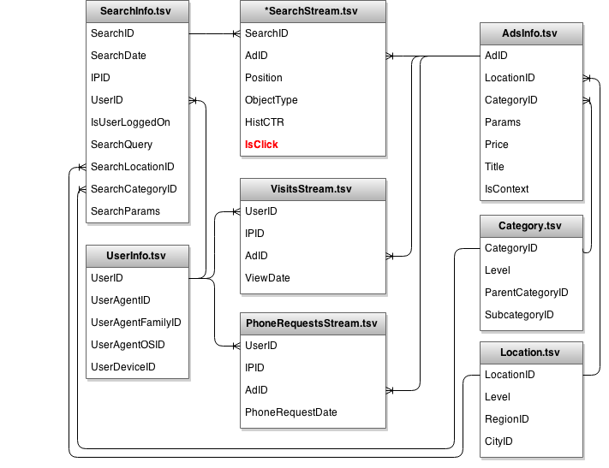
Our data
40GB SQL database of data from a week is provided by Avito

Slide 10
Prediction of Ad Click

Slide 11
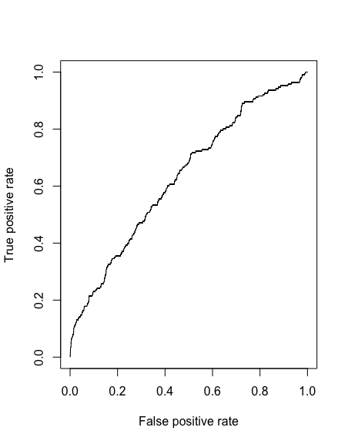
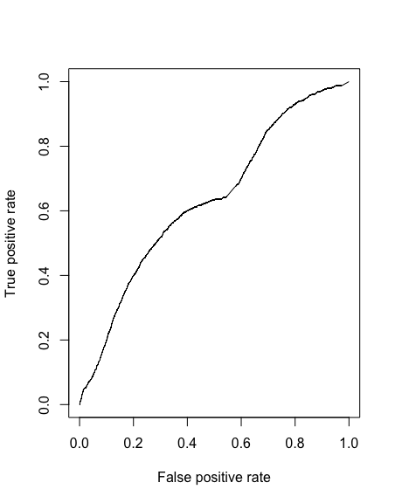
Machine Learning Models
HistCTR + Position
Logistic Regression
AUC - 0.6316261
Position + HistCTR + CategoryID + Price
Logistic Regression
AUC - 0.6327004

Slide 12
Approaches
Classification, Simple models work best in case of large amounts of data.
Cost-Sensitive Learning is a type of learning in data mining that takes the misclassification costs (and possibly other types of cost) into consideration
Alternate approach, regression to calculate probability of click.

Slide 13
100,000,000
data points is what it takes.

Slide 14
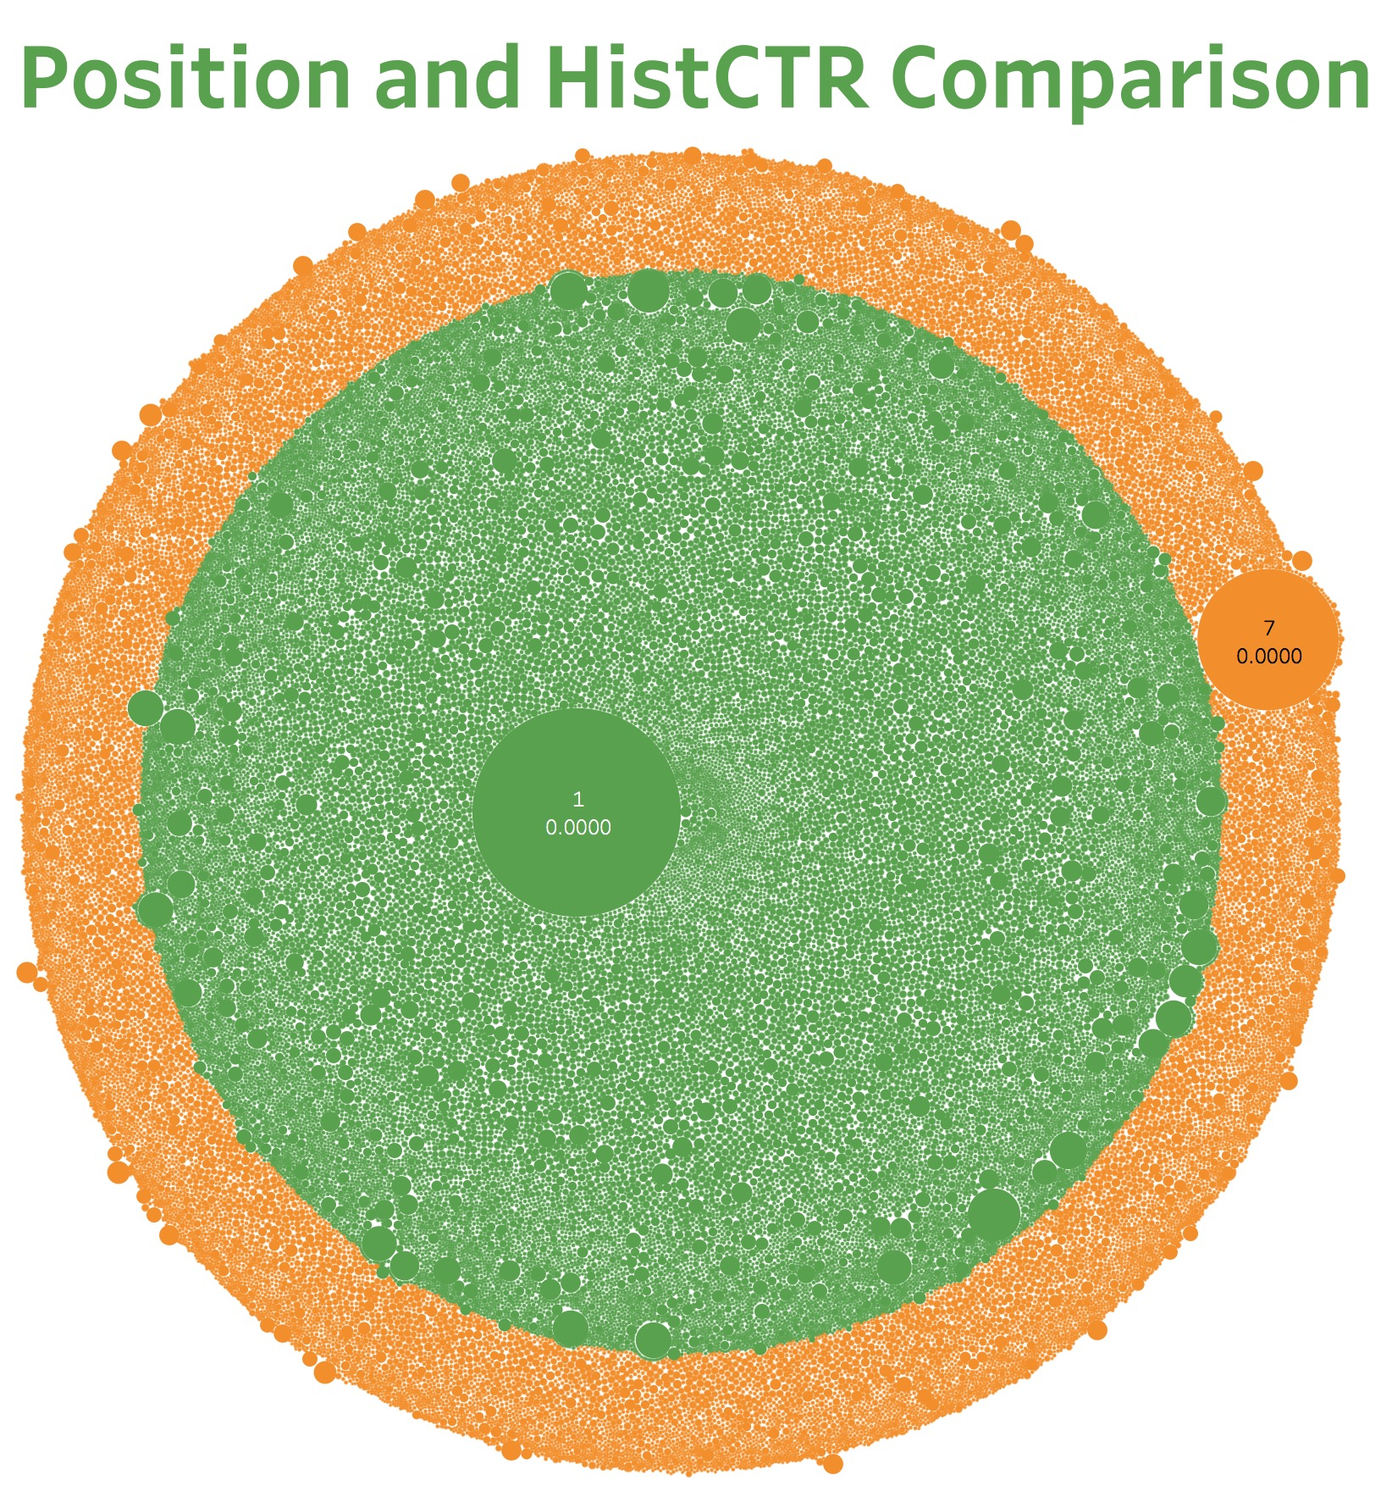

Slide 15

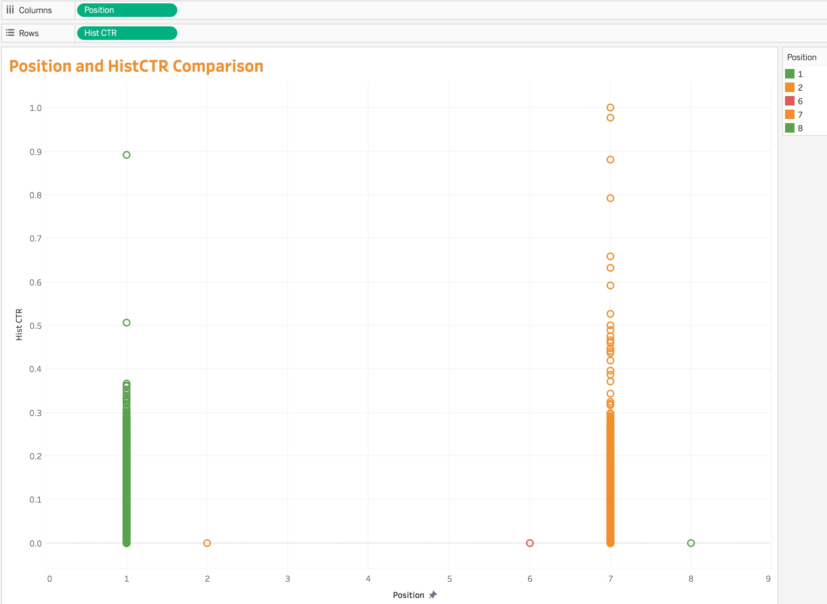
Ads having CTR > 0.4 gets clicks even if they are listed at Position 7

Slide 16
Presenting the Data
Hosting the data and models that were locally built.
A server end to do the computation and create a visualization
A user interface to present the visualization and the computation.
https://krthk.shinyapps.io/Prob_Click_Cat_Pos/

Slide 17
Github
It's a version control tool.
Hosts all our data as flat files.Comma delimited files.
It also holds the models that were built.
Shared amongst team members.

Slide 18
Shiny
Shiny is solution provided by RStudio and it’s makers.
Shiny can host the server script and UI script.
This is done using two scripts in R. ui.R and server.R
Shiny uses “reactive” variables.
Variable is recaptured with every interaction.

Slide 19
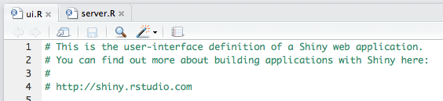
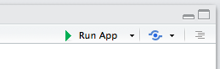
Shiny

Slide 20
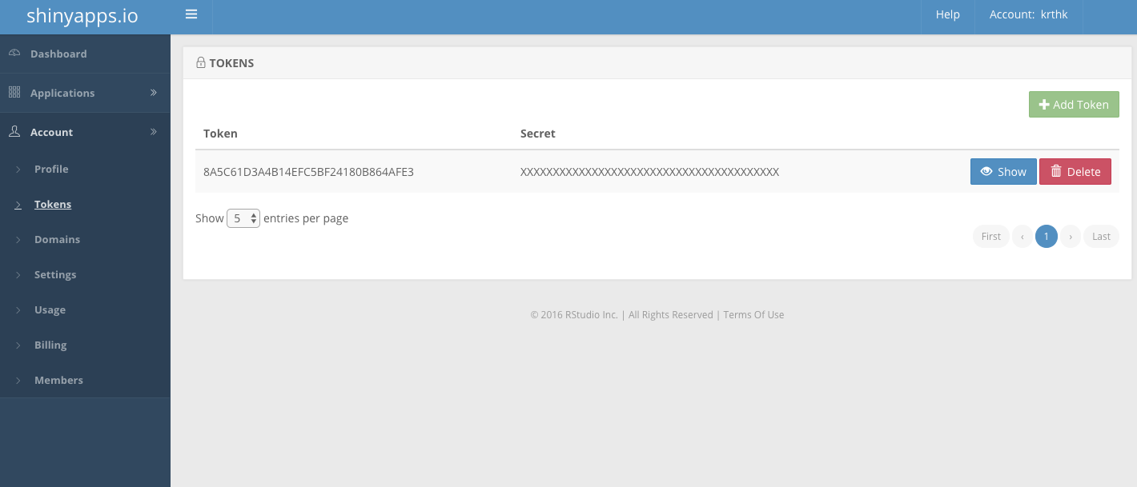
Shiny

Slide 21

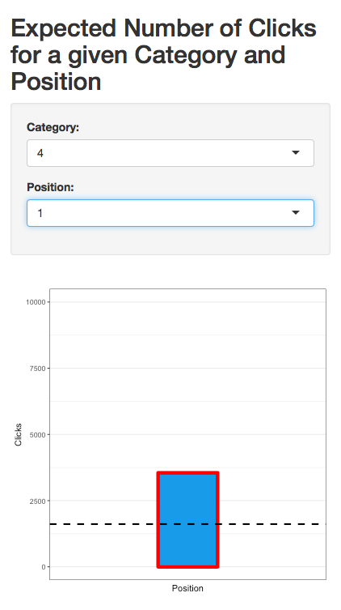
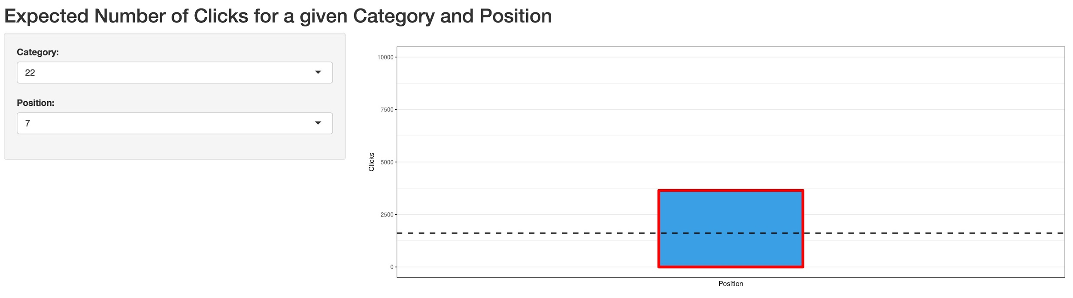

Slide 22
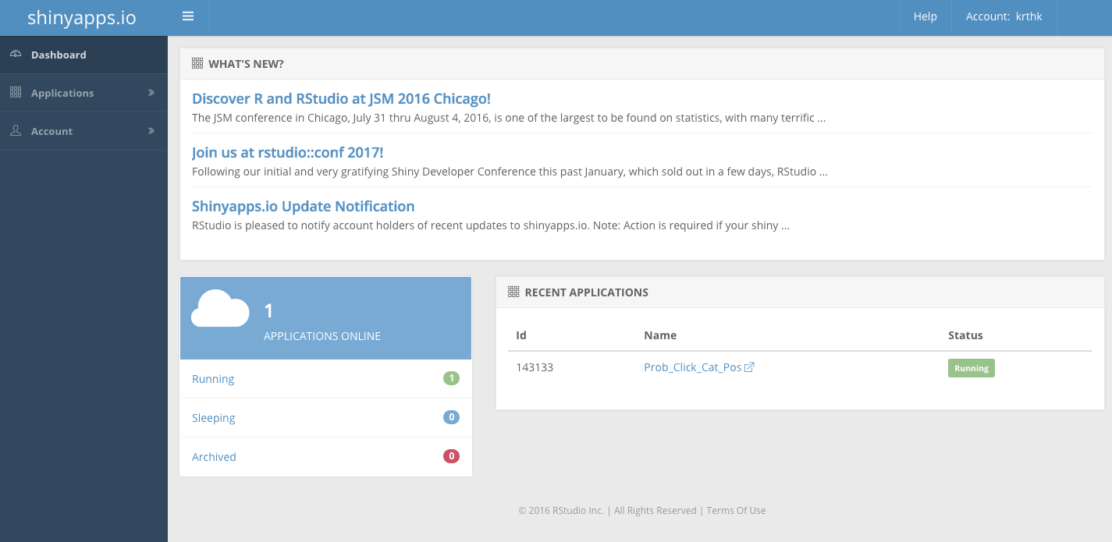
Shiny

Slide 23
Thanks!

